Slide 1
Group task: S.Elsayed A.Ullah K.Serit The name of the game: Tailor Age group : 6-9 age (31.07.2020)

Slide 2

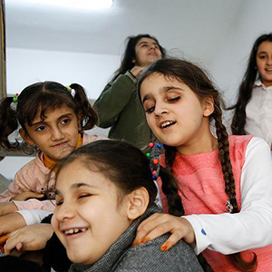
Goal; the child's fun is to help develop both auditory and tactile…

Slide 3
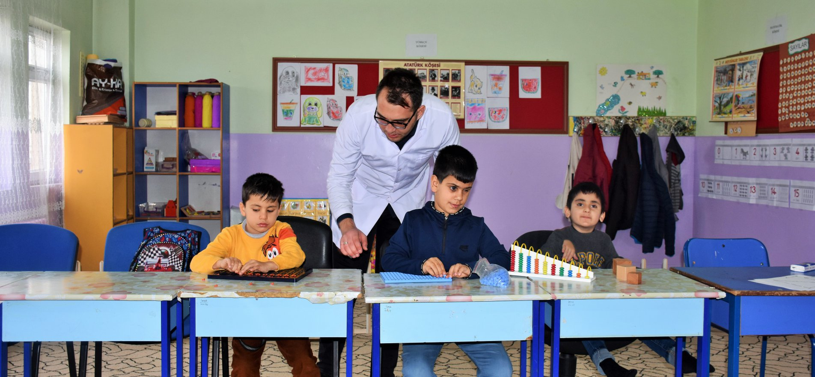
There are 3 children and an adult in the game. If there is only one child, two chairs are used instead of the other two.

Slide 4
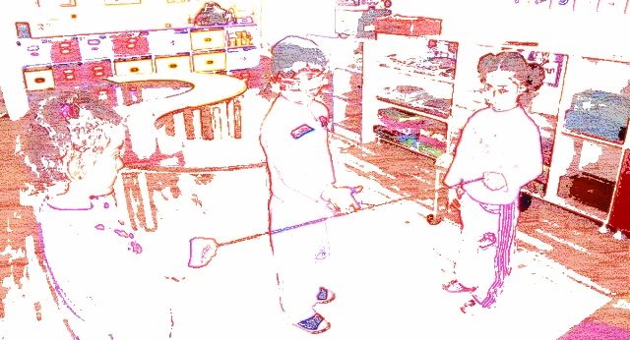
A 2 meter rope is stretched between two children (they hold the rope with their hands). A ribbon is made at the "rope" midpoint. The 3rd child is asked to cut the rope from this point with the toy scissors.

Slide 5

The aim is to bring the visually impaired child to the rope with a voice and cognitive orientation at a distance of 12 steps and cut the rope.

Slide 6
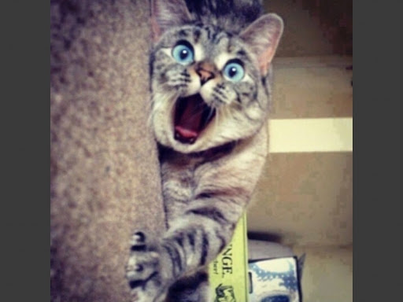

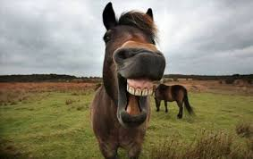
The rules of the game are explained to the visually impaired child before starting the game.
If a cat hears a meow, it will take 1 step forward.
If a dog hears the sound, it will take 1 step to the right.
If a horse hears the sound, it will take 1 step to the left.

Slide 7


Finally
When he approaches the rope, he will grab the rope and will come to the point where the ribbon is and try to cut the rope from that point.
This orientation will be made by saying that the adult is more or less left and right.

Slide 8
Now,
we switch to the game application…

Slide 9


Slide 10

Thank you for watching…

